Slide 1
Lords – An Online Deck-Building Game
Tyler Thorn - 1603041

Slide 2
Project Summary
Create an online deck-building game.
Deck-building game can be interpreted two ways:
A game where the deck-building is the focus of the gameplay (e.g. Dominion).
A game where deck-building happens prior to the core gameplay (e.g. Magic: The Gathering, Hearthstone).
I use the second interpretation for this project.

Slide 3
Context
Plenty of deck-building games to look at on the market already.
The most popular ones tend to be Trading Card Games (TCGs)
By 2011, Yu-Gi-Oh! had sold over 25 billion cards.
Three main sources of information for this project:
Game Developer Conference (GDC) Talks
Deck-building games on the market (e.g. Yu-Gi-Oh!)
Online Unity Tutorials
I had prior experience with Unity but wanted to improve further.

Slide 4
Context – GDC Talks
GDC is an annual conference for video game developers.
However table-top game developers also attend and present.
Two of these talks were very useful:
Mark Rosewater’s Magic: The Gathering: 20 Years, 20 Lessons Learned
Lead Designer of Magic: The Gathering giving 20 tips based on his life experience designing Magic: The Gathering.
Dylan Mayo’s Balance Mechanics For Your Card Game’s Unique Power Curve
Game Design Manager for Pokémon Trading Card Game using Hearthstone as an example for balancing cards in TCGs.

Slide 5
Context – Other Card Games
I looked at other TCGs for 3 main design elements:
Reducing the impact of luck.
Designing card effects.
Managing resources and takings risks.
Looked at successful TCGs I had experience playing:
Yu-Gi-Oh!
Hearthstone
Pokemon Trading Card Game

Slide 6
Context – Reducing luck’s impact
All card games have an element of luck.
That’s part of the fun, except when you’re unlucky.
Yu-Gi-Oh! addresses this with the Extra Deck mechanic.
Helps with consistency, but difficult for new players.
Hearthstone gives the player an ability of their own, based on their class.
Always available for use, but not impactful enough.
Result – Lords cards (hence the name, Lords).
A card that starts in play (always available).
High impact and central to a player’s strategy.

Slide 7
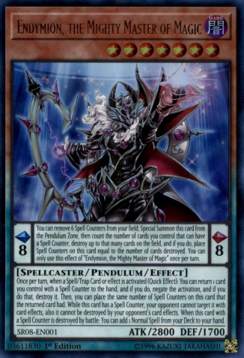
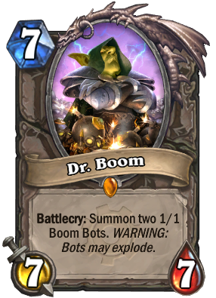
Context – Designing Card Effects
Yu-Gi-Oh! Vs Hearthstone

Slide 8
Context – Designing Card Effects
Result – Simple card effects that use keywords.
Helps newer players.
More efficient use of space.

Slide 9
Context – Designing Card Effects
Result – Simple card effects that use keywords.
Helps newer players.
More efficient use of space.
Mark Rosewater said keywords help players learn mechanics in his GDC talk.

Slide 10
Context – Managing Resources and Risk
Resource management is crucial to playing TCGs at a competitive level.
Resources include:
Cards.
Health.
Mana/Stamina/Summon limits – A pool that player’s must draw from that limits their actions per turn.
The more entwined these resources are the more impactful each decision is.
Investing these resources is a risk.

Slide 11
Context – Managing Resources and Risk
Pokémon Trading Card Game has an interesting example of risk.
Players win by taking 6 prize cards.
These are earned by defeating the opponent’s Pokémon.
The most powerful Pokémon (GX/EX Pokémon) give TWO prize cards when defeated.
This creates a high-risk high-reward situation when playing these cards.

Slide 12
Context – Managing Resources And Risk
I wanted to emulate this high-risk decision making in my game.
Result - All cards require an investment to play.
However unlike most other popular TCGs, Mana and Health are not distinct.
They are combined into one currency gold.
Spend gold to play cards, but lose when you run out of gold.
Playing cards makes you closer to losing the game, but is necessary to win.
Adds an extra layer of depth to each decision.

Slide 13
Context – Online Unity Tutorials
Two main Unity tutorials used
Both created by the channel “Quill18Creates”.
Both helped the implementation of this game.
“Unity Tutorial - Drag & Drop Tutorial”
Details implementation of a GUI that allows users to drag elements from one segment of the screen to another.
Very applicable to card games.
“Unity 3D: Multiplayer First-Person Shooter”
Tutorial on using UNet to create multiplayer games in Unity.
UNet eventually not used for many reasons

Slide 14
Aims & Objectives
Three Primary Objectives:
Create a deck-builder tool that allows players to build decks from a pool of over 100 cards.
Create online functionality, allowing players to play with each other remotely (different households, cities, etc.).
Introduce Trading Card Game (TCG) players to the game, and improve it based on their feedback.
Produced a Game Design Document outlining the design of the game (including rules, features, etc.).

Slide 15
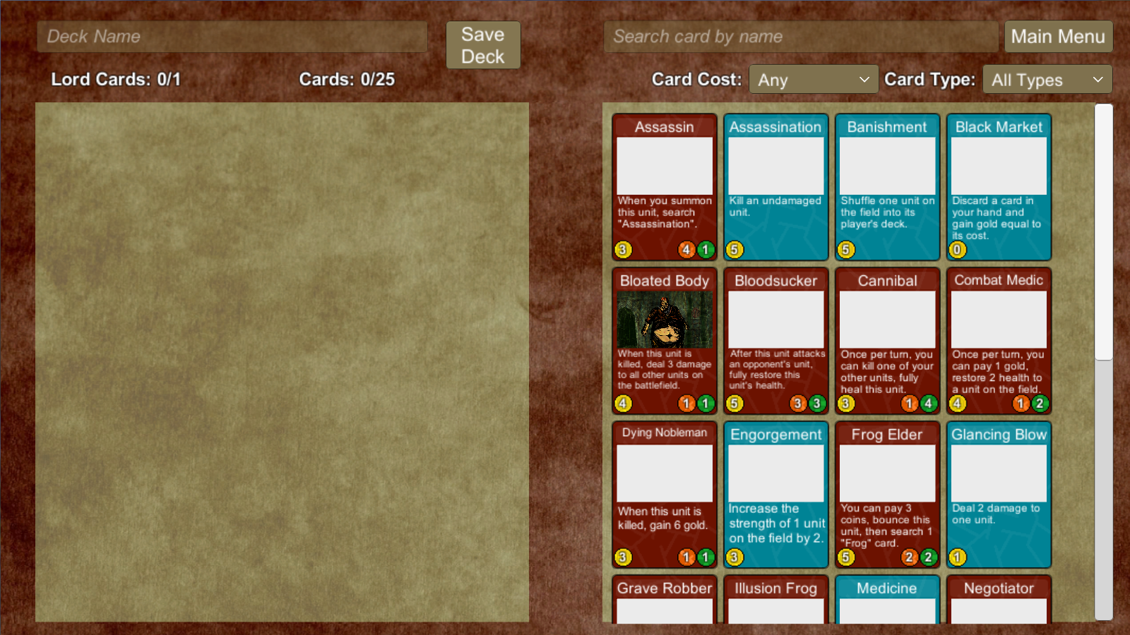
Final Product – Deck-Builder

Slide 16
Final Product – Deck-Builder
Functioning deck-builder that players can use to create multiple decks.
Validates decks to make sure they follow the game rules.
Players can search for cards by name, cost, or card type.
28 Cards (goal was 100).
Future improvements:
More cards.
More search parameters.
Allow players to modify existing decks.

Slide 17
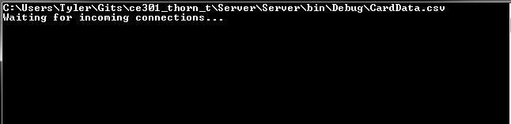
Final Product – Online Functionality
Players can play remotely using a server hosted on my PC currently.
Implemented in C#.
UNet had some problems.
Server can handle multiple simultaneous games.

Slide 18
Final Product – Server Implementation
Server assigns an ID to every card in both player’s decks.
Server and client use keywords to refer to functions
Card IDs and values used as arguments for these functions
A message to the client might be “KILL#Cannibal43”
This means to kill the card with the ID “Cannibal43”.
Future improvements:
Test with a large player-base.
Constantly host the server on a remote VM.
Allow players to play with their friends.

Slide 19
Final Product – Play-testing Feedback
Playtesting was minimal due to falling behind schedule.
Could only start playtesting later in the projects lifetime.
The feedback I did get was useful and was used to improve the game.
Future work:
Introduce Lords to more players.
Gather feedback to help with game balance and polish.

Slide 20
How To Play (Summarized)
Players each create decks from the pool of cards
Each deck contains 25 cards plus 1 Lord card.
Each player starts with 25 gold.
Players spend gold to play cards.
Units can attack other units and reduce your opponent’s gold.
Utilities are one-time use cards.
Lords start in play and have powerful effects.
First player to 0 gold loses.
Players can check the rules any time by clicking the “?” button, or “How To Play” on the main menu.

Slide 21
Demonstration

Slide 22
Future Work
Improve the aesthetic of the game.
Most cards are missing artwork.
Animations and sound effects to help players track the game state.
Increase the card pool (at least 100 cards).
Server should constantly be running.
Gather player feedback and improve game from it.

Slide 23
Lessons for the future
Two key points:
Research tools more thoroughly in the future.
UNet was an unfortunate waste of time.
Plan around other work and responsibilities.

Slide 24
Questions?

